Slide 1

Attracting Research and Development to New Zealand
Presentation for the American Chamber of Commerce

Slide 2
Attracting Investment to New Zealand
The Investment Attraction Taskforce is designed to deliver the strategy and support a step-change in New Zealand’s investment attraction efforts, to unlock barriers and enable the seamless facilitation of investment opportunities.

Slide 3
Attracting Multinational R&D Investment to New Zealand
Aim to attract 10 multinationals by 2020
Objectives:
  Build a more internationally connected science system
  Contribute to lifting BERD
  Enhance R&D investment ecosystem
  Build NZ’s reputation as an R&D location
  Enhance our reputation as a great place to do business

Slide 4
Our global rankings – a great starting point
1st
1st
2nd
best country in the world to do business with
for Entrepreneurship
for corporate ethics and accountability
1st
3rd
1st
for trust-worthiness and confidence
in world for investor protection and monetary freedom
in world for economic freedom and opportunity
1st
2nd
4th
highest investment level in digital network
easiest place in the world to do business
most attractive investment destination in the world

Slide 5

The flip-side…
Ideal test-bed
Small
Nimble and responsive government
Privacy
Remote
Disease-free agricultural environment

Slide 6
How will we achieve this?
Building on existing capability
Building enabling environments
To create opportunities of sufficient scale and interest to multinationals

Slide 7
Shape of the Programme
Prit
Priority Area – Area where NZ has competitive strength in R&D, where NZ businesses/industry are present, and where some MNC’s are present
Platform Play - Ecosystem-level schemes that build the NZ offering
Pipeline - Pipeline of opportunities from MNC’s that synergise with the priority area and platform play
Priority Area
Platform Play
Pipeline

Slide 8
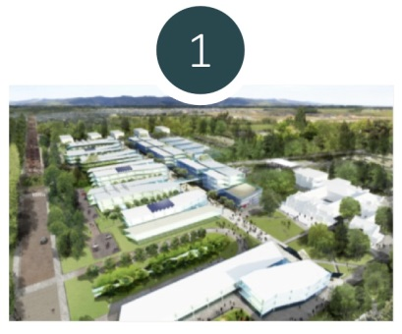



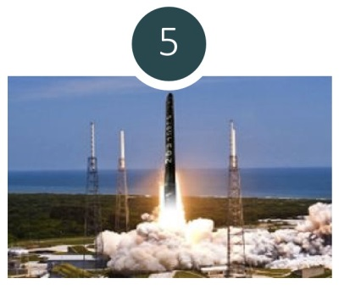
Priority Areas
HEALTH
TECHNOLOGIES
HIGH VALUE NUTRITION
AGRITECH
DIGITAL
SPACE

Slide 9
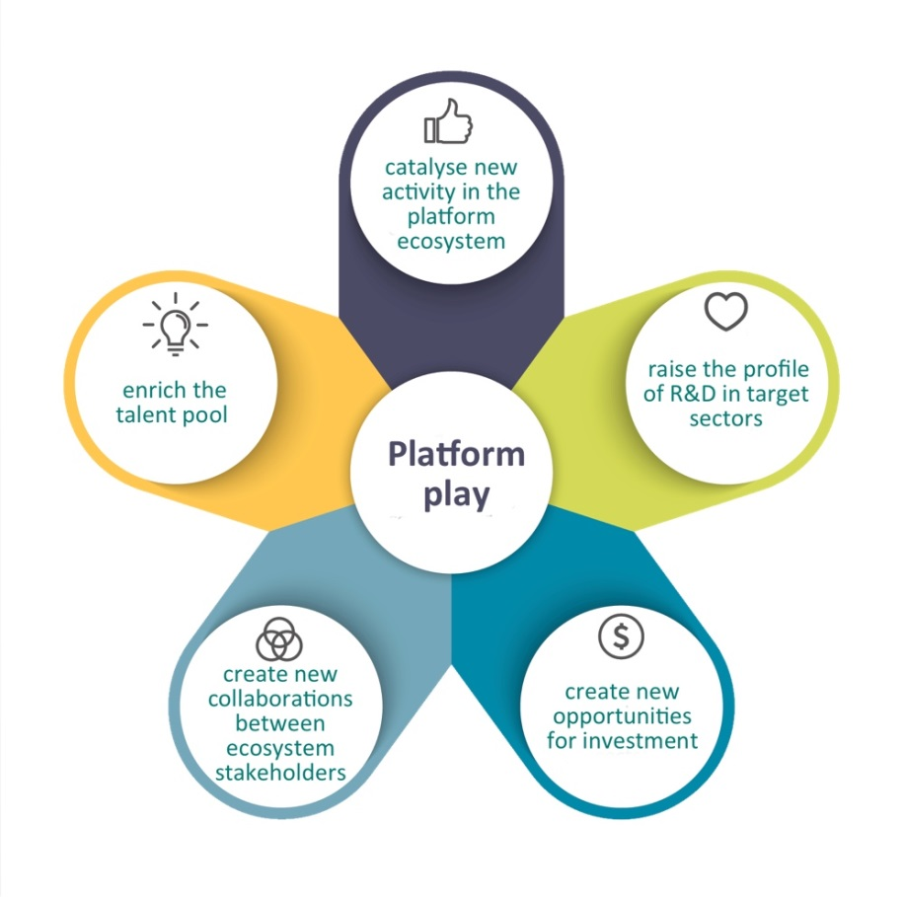
Platform Plays
Ecosystem-level schemes where the development of the core project builds capability in NZ and produces a sustainable stream of MNC investment opportunities

Slide 10
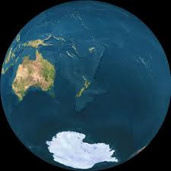
Platform Play – Space
Priority Area
geographical factors - un-congested air and water space - enabling regulatory regime - regional research institute - Five Eyes and TSA agreements - political stability -excellent international relationships
Platform Play
rapidly advance current opportunities - grow space innovation system – grow MNC R&D opportunity – advance NZ’s reputation as responsible space-faring nation - maintain good relationships and partnerships with other Governments
9

Slide 11
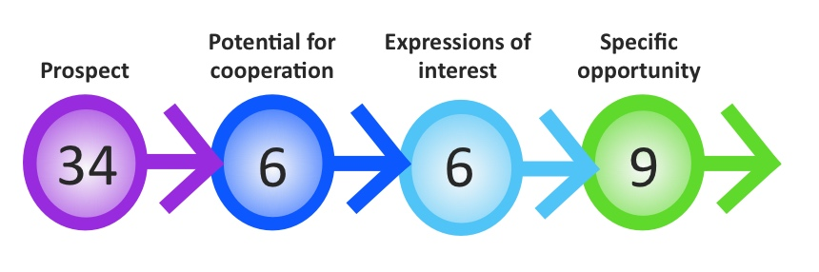
Pipeline
55 opportunities across 5 priority areas
All in different stages of development
Companies are global leaders and R&D intensive

Slide 12
Priority Area-Platform Play-Pipeline
AGRITECH
Platform Play: Lincoln Hub
DIGITAL
Platform Play: TBD
HEALTH TECHNOLOGIES
Platform Play: Bio Valley?
HIGH VALUE NUTRITION
Platform Play: Strengthen the ecosystem
SPACE
Platform Play: Access space from NZ through business-friendly environment and future-focussed regulation

Slide 13




What Have We Learnt So Far?
Fiscal incentives are important…but not for everyone
Distance is a barrier
Differentiation is key
Our value proposition…moving at the speed of innovation

Slide 14
Want to talk?
Kjesten.wiig@mbie.govt.nz
021 975 770

Slide 15

THANK YOU!!

