Slide 1
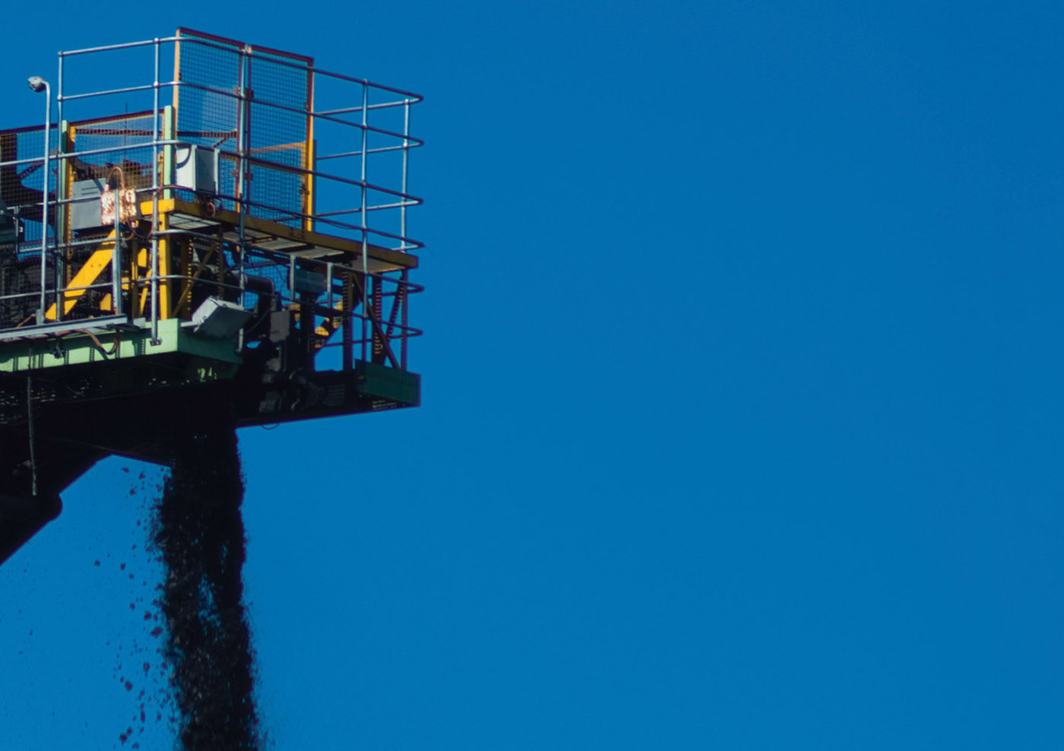
Foreign Direct Investment : A Review OF OIO Statistics
AMCHAM
Justin Ensor
Partner
October 2016

Slide 2
1
Gross vs. Net investment

Slide 3
1/3

Slide 4
2
Overseas investment fluctuates through economic cycles

Slide 5
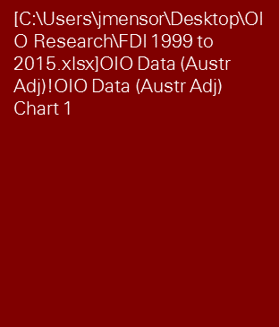
Global Financial Crisis
Threshold for Australian investors increased for approx. $477m
Per Schedules 6.5.2, 6.5.3, Gross Value for Consideration, OIO. This does not reflect the total investment, as it does not include assets included as part of the transaction.

Slide 6
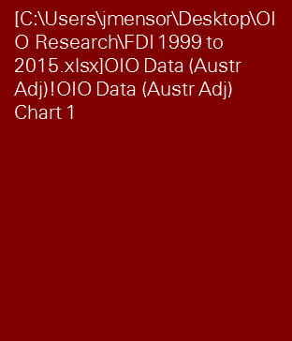
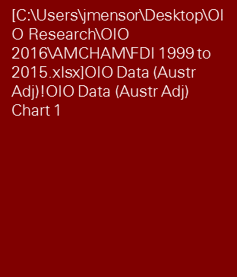
Global Financial Crisis
Threshold for Australian investors increased for approx. $477m
Per Schedules 6.5.2, 6.5.3, Gross Value for Consideration, OIO. This does not reflect the total investment, as it does not include assets included as part of the transaction.

Slide 7
3
The source of investment in any given year can vary significantly

Slide 8
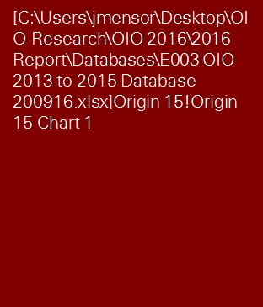

Slide 10
4
North America, Australia and increasingly Asia are our most important sources of investment

Slide 11

24%

Slide 12
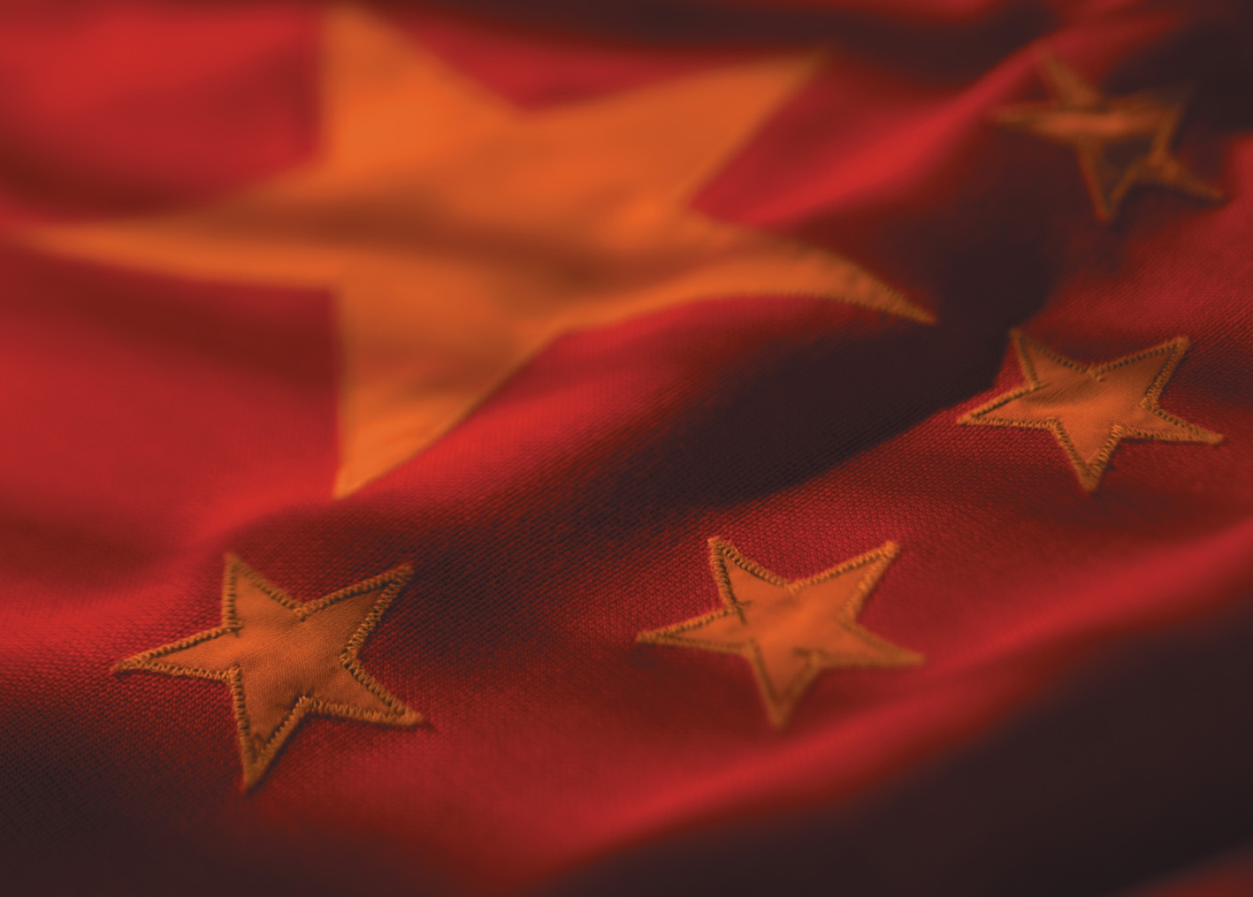
11%

Slide 13
5
Investors are chasing supply chains and yield

Slide 15
6
Investors from the United States have invested across a broad range of sectors

Slide 16
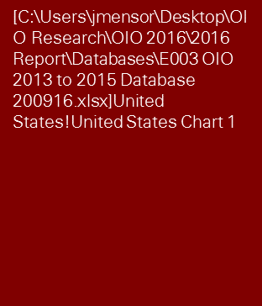

Slide 17
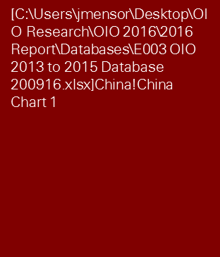

Slide 18
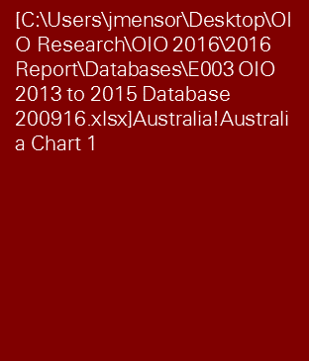

Slide 19
60%

Slide 20
27%

Slide 21
7
United States investors are also interested in agribusiness

Slide 22
58%

Slide 23
42%

Slide 25
To conclude

Slide 26
Thank you
Justin Ensor
Partner, Deal Advisory

